Slide 1
Chapter 3
Search Techniques

Slide 2
Outline
Searching
Uninformed Search Techniques
  Breadth First Search
  Uniform Cost Search
  Depth First Search
  Backtracking Search
  Depth Limited Search
  Iterative Deepening Depth First Search
  Bidirectional Search
  Search Strategy Comparison
Informed Search Techniques
  Best First Searching
    Greedy Search
    A* Search
  Local Search Algorithm & Optimization
  Iterative Improvement Algorithm
    Hill Climbing Search
    Simulated Annealing Search
  Adversarial Search Techniques
    Mini-max Procedure
    Alpha Beta Procedure

Slide 3
Searching
In Artificial Intelligence, Search techniques are universal problem-solving methods.
Rational agents or Problem-solving agents in AI mostly used these search strategies or algorithms to solve a specific problem and provide the best result.
Problem-solving agents are the goal-based agents and use atomic representation.

Slide 4
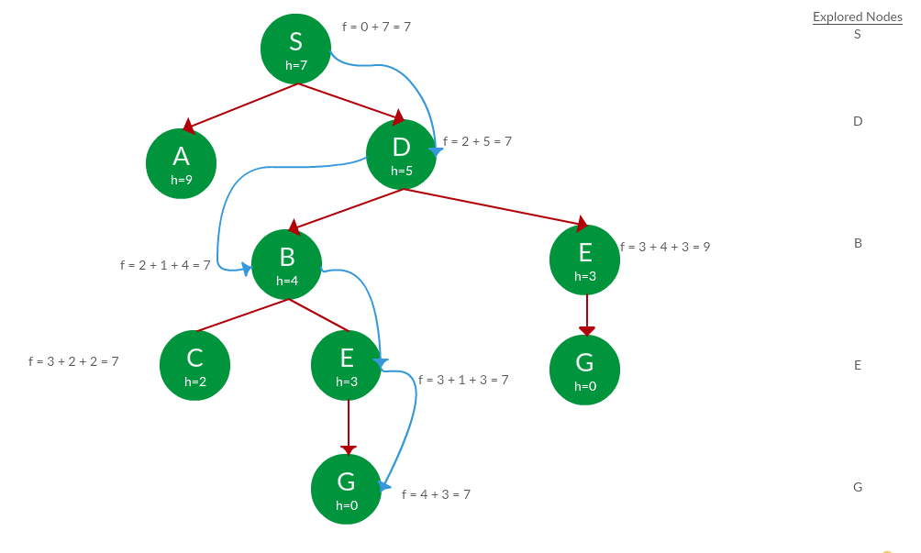

Slide 5
Many problems don’t have a simple algorithmic solution.
Casting these problems as search problems is often the easiest way of solving them.
- Useful when the sequence of actions required to solve a problem is not known
o Path finding problems, e.g., eight puzzle, travelling salesman problem
o Two player games, e.g., chess and checkers
o Constraint satisfaction problems, e.g., eight queens

Slide 6
Steps in Searching
Check whether the current state is the goal state or not?
2. Expand the current state to generate the new sets of states.
3. Choose one of the new states generated for search depending upon search strategy.
4. Repeat step 1 to 3 until the goal state is reached or there are no more state to be expanded.

Slide 7


Slide 8
Searching: Criteria to Measure Performance
Completeness: Ability to find the solution if the solution exists
Optimality: Ability to find out the highest quality solution among the several solutions
  Should maintain the information about the number of steps or the path cost
from the current state to the goal state
Time Complexity: Time taken to find out the solution
Space Complexity: Amount of Memory required to perform the searching

Slide 9
Searching: Types
Blind Search or Uninformed Search
Informed Search or Heuristic Search

Slide 10
Searching: Problem Classification
Ignorable: Intermediate actions can be ignored. Example: Water Jug Problem
Recoverable: The actions can be implemented to go the initial states. Example: 8 Puzzle Games
Irrecoverable: The actions can’t be implemented to reach the previous state. Example: Tic-Tac-Toe
Decomposable: The problem can be broken into similar ones. Example: Bike Racing

Slide 11
Uninformed Search Algorithm
Whoever it may be (humans or AI) need to think of all possible ways to reach the goal state(if it exists) from the initial state, all the consequences, etc.
Similarly, AI systems use various search algorithms for a particular goal state(if it exists).
As the name ‘Uninformed Search’ means the machine blindly follows the algorithm regardless of whether right or wrong, efficient or in-efficient.

Slide 12
These algorithms are brute force operations, and they don’t have extra information about the search space; the only information they have is on how to traverse or visit the nodes in the tree.
Thus uninformed search algorithms are also called blind search algorithms.
The search algorithm produces the search tree without using any domain knowledge, which is a brute force in nature.
They don’t have any background information on how to approach the goal or whatsoever.
But these are the basics of search algorithms in AI.

Slide 13
Breadth First Search
BFS is a traversing algorithm where you should start traversing from a selected node (source or starting node) and traverse the graph layer wise thus exploring the neighbor nodes (nodes which are directly connected to source node).
You must then move towards the next-level neighbor nodes.
As the name BFS suggests, you are required to traverse the graph breadthwise as follows:
First move horizontally and visit all the nodes of the current layer
Move to the next layer

Slide 14
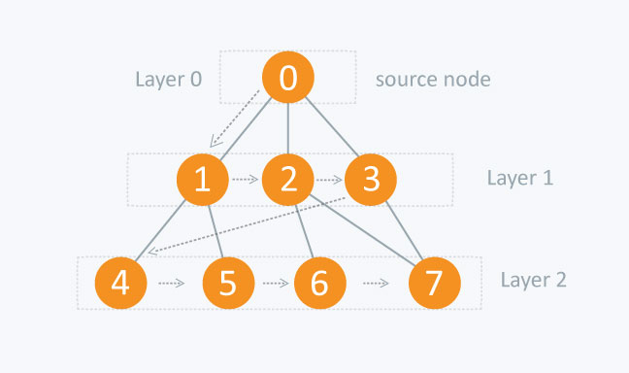

Slide 15
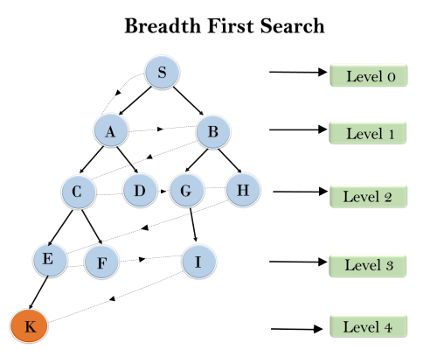
S---> A--->B---->C--->D---->G--->H--->E---->F---->I---->K

Slide 16
Advantages:
BFS will provide a solution if any solution exists.
If there is more than one solution for a given problem, then BFS will provide the minimal solution which requires the least number of steps.
Disadvantages:
It requires lots of memory since each level of the tree must be saved into memory to expand the next level.
BFS needs lots of time if the solution is far away from the root node.

Slide 17
Breadth First Search: Four Criteria
Completeness
  d: depth of the shallowest goal
  b: branch factor
  This search strategy finds the
Shallowest(of little depth) goal first
  Complete, if the shallowest goal is at some finite depth
Optimality
  If the shallowest goal nodes were available, it would already have been reached
  Optimal, if the path cost is a non- decreasing function of the path of the node

Slide 18
Breadth First Search: Four Criteria
Time Complexity
  For a search tree a branching factor ‘b’ expanding the root yields ‘b’ nodes at the first level.
  Expanding ‘b’ nodes at first level yields b² nodes at the second level.
  Similarly, expanding the nodes at (d+1)^{th} level yields b^{d} node at d^{th} level
  If the goal is in d^{th} level, in the worst case, the goal node would be the last node in the d^{th} level
Hence, We should expand (b^{d}-1) nodes in the d^{th} level (Except the goal node itself which doesn’t need to be expanded)
So, Total number of nodes
generated at d^{th} level = b(b^{d}-1)
=b^{d+1}-b
Again, Total number of nodes
generated = 1+b+b²+…+b^{d+1}-b
=O(b^{d+1})=O(b^{d})
Hence, time complexity is O(b^{d+1}) where, b= branching factor and d= level of goal node in the search table

Slide 19
Breadth First Search: Four Criteria
Space Complexity
  Same as time complexity
  i.e. O(b^{d+1})
  Since each node has to be kept in
the memory
Disadvantages
  Memory Wastage
  Irrelevant Operations
  Time Intensive
  It doesn’t assure the optimal cost solution

Slide 20
Applications Of Breadth-First Search Algorithm
Crawlers in Search Engines: Breadth-First Search is one of the main algorithms used for indexing web pages
GPS Navigation systems
Find the Shortest Path & Minimum Spanning Tree for an unweighted graph
Broadcasting
Peer to Peer Networking

Slide 21
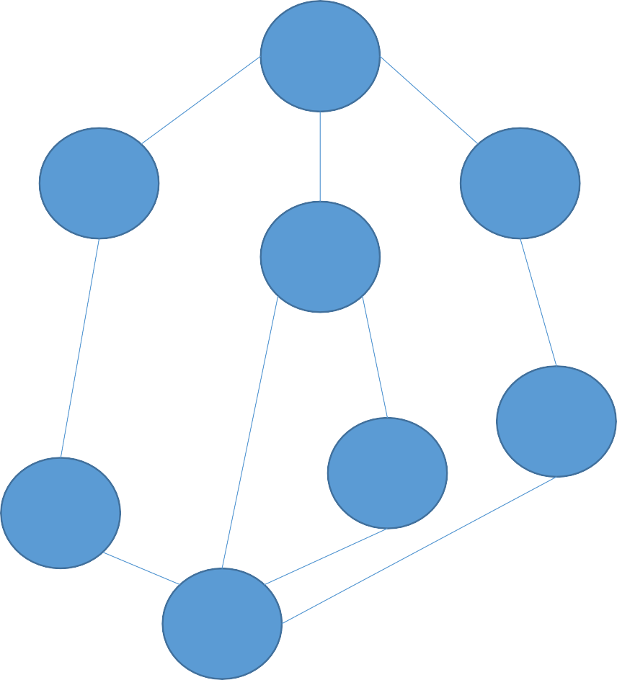
Uniform Cost Search
It expands the lowest cost mode on the fringe
3
A
1
The first solution is guaranteed to be the cheapest one because a cheaper one would have expanded earlier and so would have been found first
Required Condition: A to H
  ABEH=21, ACH=5, ACFH=7, ADIH=6
4
B
D
C
2
12
2
1
I
F
E
1
8
H
1

Slide 22
Uniform Cost Search
Solution: Required Operation
  Expand A→ Yield B, C, D With AB=1, AC=4, AD=3
  Expand B→ Yield E with ABE=13
As ABE>AC and ABE>AD
  Expand D→ Yield I with ADI=5 As ADI>AC
  Expand C→ Yield H and F with
ACH=5 and ACF=6
  Solution Achieved
If all step costs are equal, it is identical breadth first search
3
A
1
4
B
D
C
2
12
2
1
I
F
E
1
8
H
1

Slide 23
Assignment

Slide 24
Advantages
  It helps to find the path with the lowest cumulative cost inside a weighted graph having a different cost associated with each of its edge from the root node to the destination node.
  It is considered to be an optimal solution since, at each state, the least path is considered to be followed.
Disadvantages
    Doesn’t care about the number of steps a path has but only about their cost
    It might get stuck in an infinite loop if it expands a node that has a zero cost action leading back to same state

Slide 25
Uniform Cost Search: Four Criteria
Completeness
  Complete, if the cost of every step is greater than or equal to some small positive constant E
Optimality
  The same ensures optimality
Time Complexity
  O(b ^{C*/E})
  Where C*→ cost of optimal path and E→ small positive constant
  This complexity is much greater than that of Breadth first search
Space Complexity
  O(b ^{C*/E})

Slide 26
Depth- First Search (DFS)
DFS proceeds down a single branch of the tree at a time.
- It expands the root node, then the leftmost child of the root node, then the leftmost child of that node etc.
- Always expands a node at the deepest level of the tree
- Only when the search hits a dead end (a partial solution which can’t be extended) does the search backtrack and expand nodes at higher levels.

Slide 27
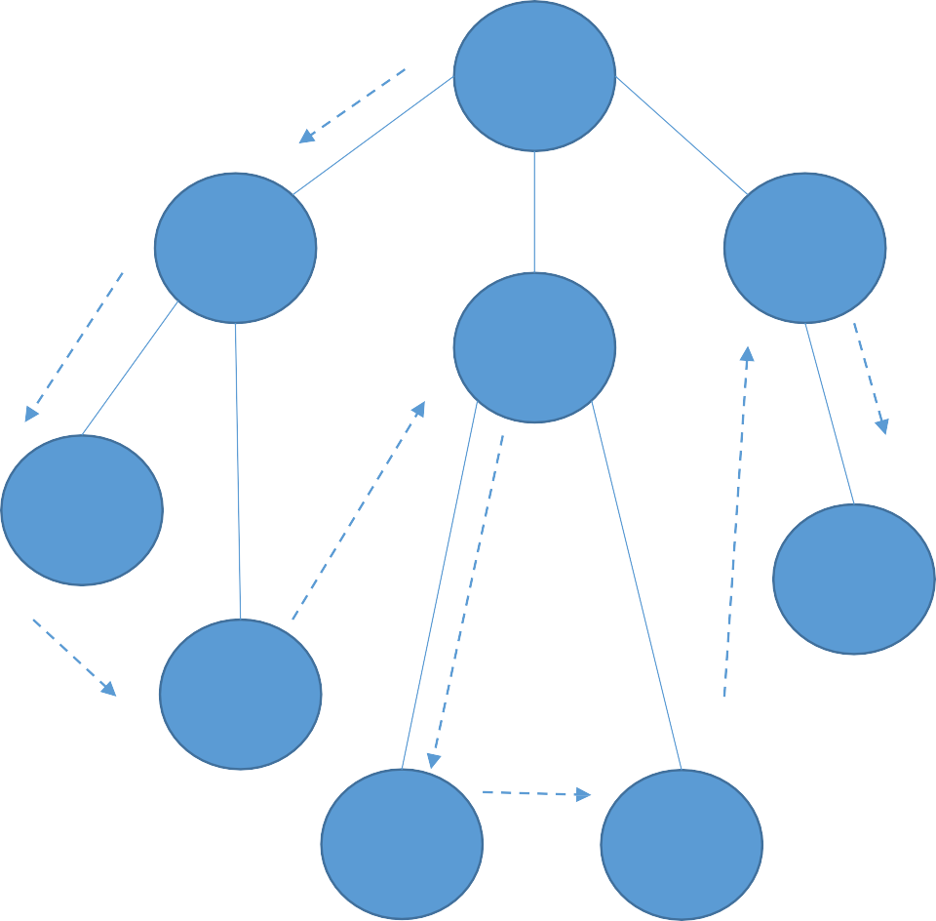
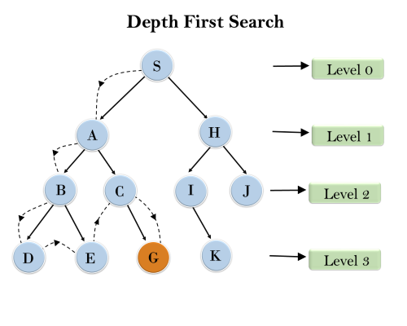

Slide 28
Depth First Search: Four Criteria
Completeness
  Can get stuck going down the wrong path
  It will always continue downwards
without backing up
  If the path chose get infinitely down, even when shallow solution exists
  Not complete
Optimality
  The strategy might return a solution path that is longer than the optimal solution, if it starts with an unlucky path
  Not optimal

Slide 29
Depth First Search: Four Criteria
Space Complexity
  It needs to store a single path from root to a leaf node and the remaining unexpanded sibling nodes for each node in the path
  For a search tree of branching factor ‘b’ and maximum tree depth ‘m’, only the storage of b_{m+1} node is required
  Hence,
Space Complexity= O(b.m+1)
= O(bm)
Time Complexity
  O(b^{m}), in the worst case, since in the worst case all the b^{m} nodes of the search tree would be generated
  Hence,
Time Complexity= O(b^{m})

Slide 30
Applications
Depth-first search is used in topological sorting, scheduling problems, cycle detection in graphs, and solving puzzles with only one solution, such as a maze or a sudoku puzzle.
Other applications involve analyzing networks, for example, testing if a graph is bipartite.

Slide 31
Depth Limited Search
Modification of depth first search
Depth first search with predetermined limit ‘l’
After the nodes at the level ‘l’ are explored, the search backtracks without going further deep
Hence, it solves the infinite path problem of the depth first search strategy
Completeness: DLS search algorithm is complete if the solution is above the depth-limit.
Optimality: Depth-limited search can be viewed as a special case of DFS, and it is also not optimal even if ℓ>d.
Time Complexity=O(b^{l})
Space Complexity=O(bl)

Slide 32
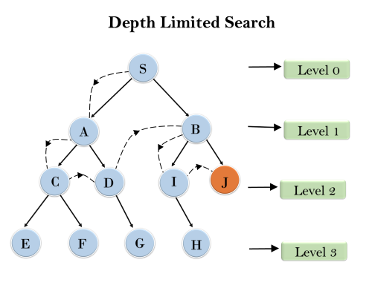

Slide 33
Advantages:
Depth-limited search is Memory efficient.
Disadvantages:
Depth-limited search also has a disadvantage of incompleteness
It may not be optimal if the problem has more than one solution

Slide 34
Applications
Detecting cycle in a graph. ...
Path Finding. ...
Topological Sorting. ...
To test if a graph is bipartite. ...
Finding Strongly Connected Components of a graph A directed graph is called strongly connected if there is a path from each vertex in the graph to every other vertex.

Slide 35
Iterative Deepening Depth First Search
IDDFS combines depth-first search’s space-efficiency and breadth-first search’s fast search (for nodes closer to root).
We do a limited depth-first search up to a fixed “limited depth”.
Then we keep on incrementing the depth limit by iterating the procedure unless we have found the goal node or have traversed the whole tree whichever is earlier.

Slide 36
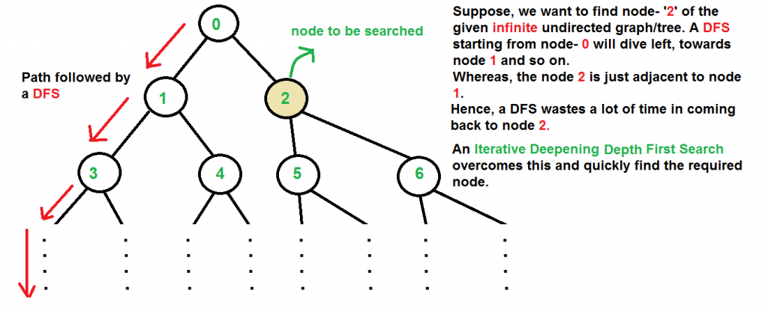

Slide 37
Here in the given tree, the starting node is A and the depth initialized to 0.
The goal node is R where we have to find the depth and the path to reach it.
The depth from the figure is 4.
In this example, we consider the tree as a finite tree, while we can consider the same procedure for the infinite tree as well.
We knew that in the algorithm of IDDFS we first do DFS till a specified depth and then increase the depth at each loop.
This special step forms the part of DLS or Depth Limited Search.

Slide 39
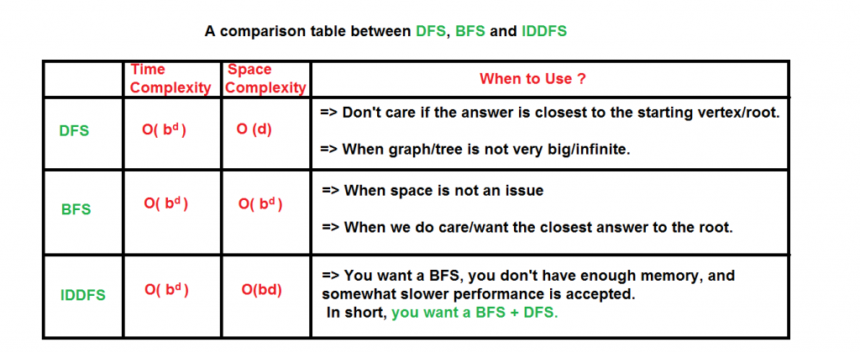

Slide 40
Bidirectional Search
Bidirectional search replaces single search graph(which is likely to grow exponentially) with two smaller sub graphs – one starting from initial vertex and other starting from goal vertex.
The search terminates when two graphs intersect.

Slide 41
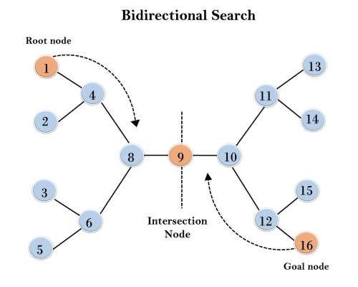
Suppose we want to find if there exists a path from vertex 0 to vertex 16.
Here we can execute two searches, one from vertex 0 and other from vertex 16.
When both forward and backward search meet at vertex 9, we know that we have found a path from node 0 to 16 and search can be terminated now.
We can clearly see that we have successfully avoided unnecessary exploration.
When to use bidirectional approach?
We can consider bidirectional approach when-
Both initial and goal states are unique and completely defined.
The branching factor is exactly the same in both directions.

Slide 42
Advantages
One of the main advantages of bidirectional searches is the speed at which we get the desired results.
It drastically reduces the time taken by the search by having simultaneous searches.
It also saves resources for users as it requires less memory capacity to store all the searches.
Disadvantages
The fundamental issue with bidirectional search is that the user should be aware of the goal state to use bidirectional search and thereby to decrease its use cases drastically.
The implementation is another challenge as additional code and instructions are needed to implement this algorithm, and also care has to be taken as each node and step to implement such searches.
The algorithm must be robust enough to understand the intersection when the search should come to an end or else there’s a possibility of an infinite loop.
It is also not possible to search backwards through all states.

Slide 43
Informed Search
Informed Search algorithms have information on the goal state which helps in more efficient searching
These search find solutions more efficiently by the use of heuristics
Heuristic is a search technique that improves the efficiency of the search process
By eliminating the unpromising states and their descendants from consideration, heuristic algorithms can find acceptable solutions

Slide 44
Informed Search
The informed search algorithm is more useful for large search space.
Informed search algorithm uses the idea of heuristic, so it is also called Heuristic search.
It is the approach following an informed guess of next step to be taken
It is often based on experience or intuition

Slide 45
Heuristics function
Heuristic is a function which is used in Informed Search, and it finds the most promising path.
It takes the current state of the agent as its input and produces the estimation of how close agent is from the goal.
The heuristic method, however, might not always give the best solution, but it guaranteed to find a good solution in reasonable time.
It is represented by h(n), and it calculates the cost of an optimal path between the pair of states. The value of the heuristic function is always positive.

Slide 46
Best First Search
Best First Search use an evaluation function to decide which among the various available nodes is the most promising (or ‘BEST’) before traversing to that node.
The Best first search uses the concept of a Priority queue and heuristic search.
To search the graph space, the BFS method uses two lists for tracking the traversal.
An ‘Open’ list which keeps track of the current ‘immediate’ nodes available for traversal and ‘CLOSED’ list that keeps track of the nodes already traversed.

Slide 47
Algorithm for implementing Best First Search
Step 1 : Create a priorityQueue pqueue.
Step 2 : insert ‘start’ in pqueue : pqueue.insert(start)
Step 3 : delete all elements of pqueue one by one.
Step 3.1 : if, the element is goal . Exit.
Step 3.2 : else, traverse neighbours and mark the node examined.
Step 4 : End.

Slide 48
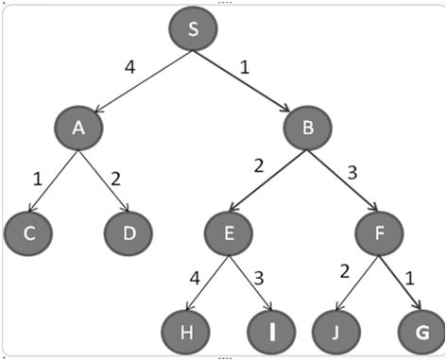
Initial state, G: goal.
Table shows the heuristic estimates:
node | h(n) | node | h(n) | node | h(n)
A | 11 | E | 4 | I,J | 3
B | 5 | F | 2 | S | 15
C,D | 9 | H | 7 | G | 0

Slide 49
Types of Best First Search
Greedy Best First Search
A* Search

Slide 50
Greedy Best First Search
Greedy best-first search algorithm always selects the path which appears best at that moment.
It is the combination of depth-first search and breadth-first search algorithms.
It uses the heuristic(quick judgement) function and search.
Best-first search allows us to take the advantages of both algorithms. With the help of best-first search, at each step, we can choose the most promising node.
In the best first search algorithm, we expand the node which is closest to the goal node and the closest cost is estimated by heuristic function, i.e.
f(n)= g(n).

Slide 51
Best First Search Algorithm
Step 1: Place the starting node into the OPEN list.
Step 2: If the OPEN list is empty, Stop and return failure.
Step 3: Remove the node n, from the OPEN list which has the lowest value of h(n), and places it in the CLOSED list.
Step 4: Expand the node n, and generate the successors of node n.
Step 5: Check each successor of node n, and find whether any node is a goal node or not. If any successor node is goal node, then return success and terminate the search, else proceed to Step 6.
Step 6: For each successor node, algorithm checks for evaluation function f(n), and then check if the node has been in either OPEN or CLOSED list. If the node has not been in both list, then add it to the OPEN list.
Step 7: Return to Step 2.
h(n)= estimated cost from node n to the goal.

Slide 52
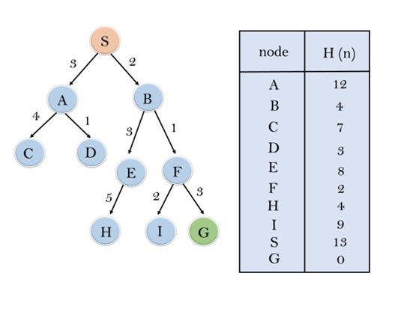
Example:
At each iteration, each node is expanded using evaluation function f(n)=h(n) , which is given in the below table
In this search example, we are using two lists which are OPEN and CLOSED Lists

Slide 53
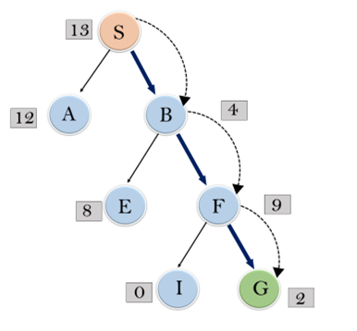
Expand the nodes of S and put in the CLOSED list
Initialization: Open [A, B], Closed [S]
Iteration 1: Open [A], Closed [S, B]
Iteration 2: Open [E, F, A], Closed [S, B]
: Open [E, A], Closed [S, B, F]
Iteration 3: Open [I, G, E, A], Closed [S, B, F]
: Open [I, E, A], Closed [S, B, F, G]
Hence the final solution path will be: S----> B----->F----> G

Slide 54
Advantages:
Best first search can switch between BFS and DFS by gaining the advantages of both the algorithms.
This algorithm is more efficient than BFS and DFS algorithms.
Disadvantages:
It can behave as an unguided depth-first search in the worst case scenario.
It can get stuck in a loop as DFS.
This algorithm is not optimal.

Slide 55
A* Search Algorithm
A* search is the most commonly known form of best-first search.
It uses heuristic function h(n), and cost to reach the node n from the start state g(n).
It has combined features of UCS and greedy best-first search, by which it solve the problem efficiently.
A* search algorithm finds the shortest path through the search space using the heuristic function.

Slide 56
This search algorithm expands less search tree and provides optimal result faster.
A* algorithm is similar to UCS except that it uses g(n)+h(n) instead of g(n).
In A* search algorithm, we use search heuristic as well as the cost to reach the node.
Hence we can combine both costs as following, and this sum is called as a fitness number.

Slide 57
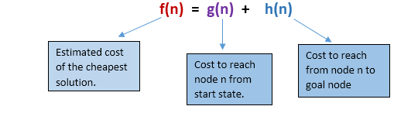

Slide 58
Algorithm of A* Search
Step1: Place the starting node in the OPEN list.
Step 2: Check if the OPEN list is empty or not, if the list is empty then return failure and stops.
Step 3: Select the node from the OPEN list which has the smallest value of evaluation function (g+h), if node n is goal node then return success and stop, otherwise
Step 4: Expand node n and generate all of its successors, and put n into the closed list. For each successor n', check whether n' is already in the OPEN or CLOSED list, if not then compute evaluation function for n' and place into Open list.
Step 5: Else if node n' is already in OPEN and CLOSED, then it should be attached to the back pointer which reflects the lowest g(n') value.
Step 6: Return to Step 2.

Slide 59
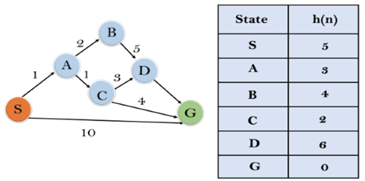

Slide 60
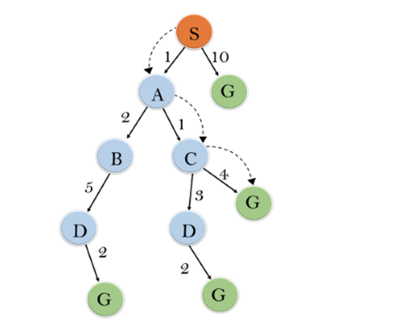
Initialization: {(S, 0)}
Iteration1: {(S--> A, 1), (S-->G, 10)}
Iteration2: {(S--> A-->C, 2), (S--> A-->B, 3), (S-->G, 10)}
Iteration3: {(S--> A-->C--->G, 6), (S--> A-->C--->D--->G, 7), (S--> A-->B-->D-->G, 10), (S-->G, 10)}
Iteration 4 will give the final result, as S--->A--->C--->G it provides the optimal path with cost 6.

Slide 61
Points to remember:
A* algorithm returns the path which occurred first, and it does not search for all remaining paths.
The efficiency of A* algorithm depends on the quality of heuristic.
A* algorithm expands all nodes which satisfy the condition f(n) <="" li="">
Complete: A* algorithm is complete as long as:
Branching factor is finite.
Cost at every action is fixed.

Slide 62
A* Search
Optimality
  Optimal if h(n) is admissible
Completness
  Complete if h(n) is admissible
Space Complexity
  O(b^{d}) if h(n) is admissible
Time Complexity
  O(b^{d}) if h(n) is admissible

Slide 63
Local Search Algorithm and Optimization
Optimization
  Aim to find the best state according to an objective function
Local Search Algorithm
  It operates using a single current state rather than multiple path and generally move only to neighbour of that state

Slide 64
Hill Climbing
Hill climbing algorithm is a local search algorithm which continuously moves in the direction of increasing elevation/value to find the peak of the mountain or best solution to the problem.
No Back Tracking
It terminates when it reaches a peak value where no neighbor has a higher value.
It is also called greedy local search as it only looks to its good immediate neighbor state and not beyond that.
A node of hill climbing algorithm has two components which are state and value.
Hill Climbing is mostly used when a good heuristic is available.

Slide 65
In this algorithm, we don't need to maintain and handle the search tree or graph as it only keeps a single current state.
Following are some main features of Hill Climbing Algorithm:
Generate and Test variant: Hill Climbing is the variant of Generate and Test method. The Generate and Test method produce feedback which helps to decide which direction to move in the search space.
Greedy approach: Hill-climbing algorithm search moves in the direction which optimizes the cost.
No backtracking: It does not backtrack the search space, as it does not remember the previous states.

Slide 66
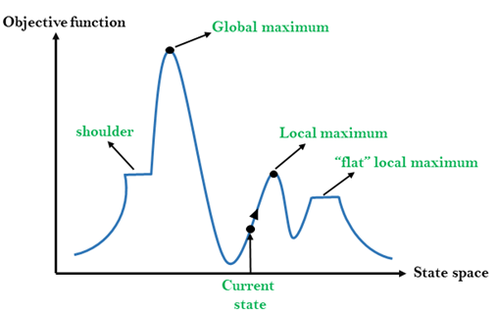

Slide 67
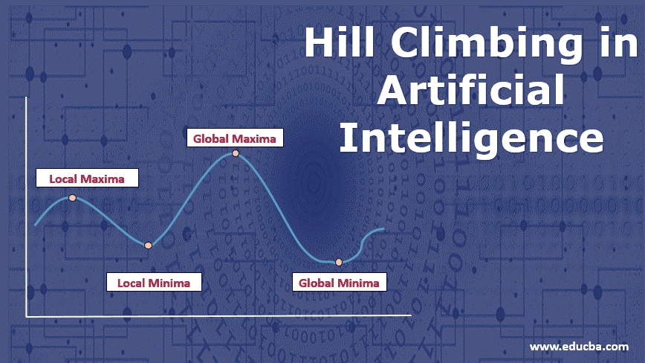

Slide 68
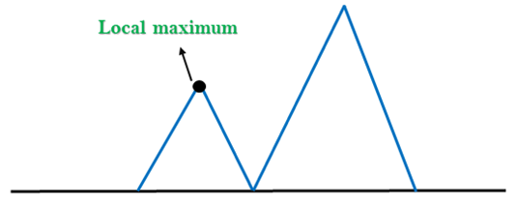
Problems in Hill Climbing
1. Local Maximum: A local maximum is a peak state in the landscape which is better than each of its neighboring states, but there is another state also present which is higher than the local maximum.
Solution: Backtracking technique can be a solution of the local maximum in state space landscape.
Create a list of the promising path so that the algorithm can backtrack the search space and explore other paths as well.

Slide 69
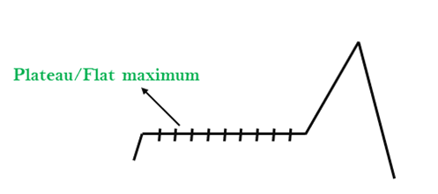
2. Plateau: A plateau is the flat area of the search space in which all the neighbor states of the current state contains the same value, because of this algorithm does not find any best direction to move. A hill-climbing search might be lost in the plateau area.
Solution: The solution for the plateau is to take big steps or very little steps while searching, to solve the problem. Randomly select a state which is far away from the current state so it is possible that the algorithm could find non-plateau region.

Slide 70
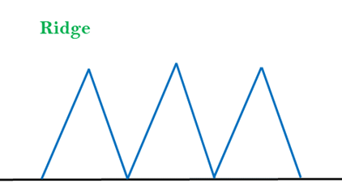
3. Ridges: A ridge is a special form of the local maximum. It has an area which is higher than its surrounding areas, but itself has a slope, and cannot be reached in a single move.
Solution: With the use of bidirectional search, or by moving in different directions, we can improve this problem.

Slide 71
Simulated Annealing:
A hill-climbing algorithm which never makes a move towards a lower value guaranteed to be incomplete because it can get stuck on a local maximum.
And if algorithm applies a random walk, by moving a successor, then it may complete but not efficient.
Simulated Annealing is an algorithm which yields both efficiency and completeness.

Slide 72
MiniMax Algorithm
Mini-max algorithm is a recursive or backtracking algorithm which is used in decision-making and game theory.
It provides an optimal move for the player assuming that opponent is also playing optimally.
Mini-Max algorithm uses recursion to search through the game-tree.
Max will try to maximize its utility(best move) and min will try to minimize its utility(worst move).
Min-Max algorithm is mostly used for game playing in AI. Such as Chess, Checkers, tic-tac-toe, go, and various tow-players game. This Algorithm computes the minimax decision for the current state.
In this algorithm two players play the game, one is called MAX and other is called MIN.

Slide 73
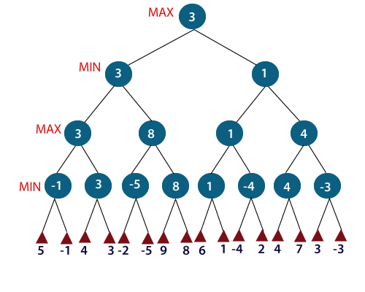

Slide 74
Alpha Beta Pruning
Alpha-beta pruning is a modified version of the minimax algorithm.
It is an optimization technique for the minimax algorithm.
The two-parameter can be defined as:
Alpha: The best (highest-value) choice we have found so far at any point along the path of Maximizer. The initial value of alpha is -∞.
2. Beta: The best (lowest-value) choice we have found so far at any point along the path of Minimizer. The initial value of beta is +∞.

Slide 75
The advantages of alpha-beta pruning are as follow :
i) Alpha-beta pruning plays a great role in reducing the number of nodes which are found out by minimax algorithm.
ii) When one chance or option is found at the minimum, it stops assessing a move.
iii) This method also helps to improve the search procedure in an effective way.

Slide 76
The disadvantage of alpha - beta pruning method is -
It has been found that alpha - beta pruning method is not feasible in most of the cases to find out the whole game tree.

